Slide 1


Object Tracking
Course: Python

Slide 2

INTERNSHIP
Internship is associated with CSI
(Computer Society of India)
Trainer : Krishna Teja - Packet prep
Mentor : Subhashini – professor

Slide 3

Team
G.VASUKI NANDAN (GNITC)
P.SARATH SURYA BHARADWAJ (GNITC)
V. HARISH (GCET)
Notes:
Notes to presenter:
What is your purpose for sharing this reflection?
Is it at the end of a unit or project?
Are you sharing this reflection, at the attainment of a learning goal you set for yourself?
Is it at the end of a course?
State your purpose for the reflection or even the purpose of the learning experience or learning goal. Be clear and be specific in stating your purpose.

Slide 4

Why Object Tracking?
Tracking objects in both structured and un-structured environments is one of the most challenging tasks in computer vision and artificial intelligence research. This project introduces a new computer vision-based object tracking for various applications. Object tracking has been driven by increase in power available in both hardware and software. The method uses webcam camera that performs in real time. In this method system keeps learning about the appearance of the object during real time.
It is related to many real time applications like vehicle perception, video surveillance and so on. In order to overcome the issue of detection, tracking related to object movement and appearance. Most of the algorithm focuses on the tracking algorithm to smoothen the video sequence. On the other hand, few methods use the prior available information about object shape, colour, and texture and so on.
Notes:
Notes to presenter:
Description of what you learned in your own words on one side.
Include information about the topic
Details about the topic will also be helpful here.
Tell the story of your learning experience. Just like a story there should always be a beginning, middle and an end.
On the other side, you can add a graphic that provides evidence of what you learned.
Feel free to use more than one slide to reflect upon your process. It also helps to add some video of your process.

Slide 5

What was your process?
Register
Login
01
04
02
03
Object Tracking
Color Selection
(Blue, Yellow, Red)
Notes:
Notes to presenter:
What did you think at first?
What obstacles did you encounter along the way?
How did you overcome those obstacles?
What images can you add to support your process?
This SmartArt allows you add images and text to help outline your process. If a picture is worth a thousand words, then pictures and words should help you communicate this reflection on learning perfectly! You can always click on Insert>SmartArt to change this graphic or select the graphic and click on the Design contextual menu to change the colors.
Feel free to use more than one slide to reflect upon your process. It also helps to add some video of your process.

Slide 6
To Run the Application
Requirements:
Software: Windows 7 or above, Mac and Linux
Hardware: Min 1GB ram, Web Cam
Modules: OpenCV, Pillow, NumPy.
Run App.py in python terminal or any python IDE
(Integrated development environment)

Slide 7
Code Functionality
Internally It will take the colour name which we will select (Red, Blue, Yellow).
That particular colour selects the HSV (Hue, Saturation, Value) color Lower range and Higher range. When the webcam is opened by Cv2. It will convert each frame
In Between colour HSV lower range and upper range is present in the frame. it will round up the colour and shows the direction.
In Cv2 each frame is transferred by the millisecond. It will Detect automatically. Until we press the ESC button it will continuously Detect.
If we press ESC it will Terminate.
If HSV value is not present in the code it will no detect.

Slide 8
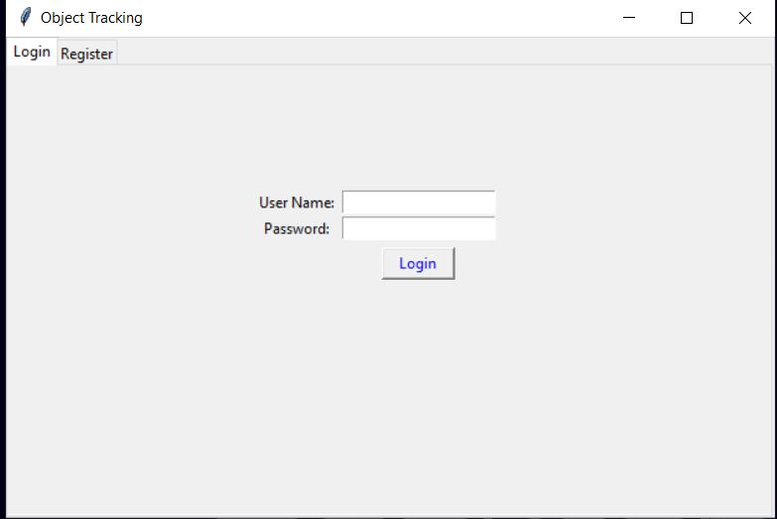
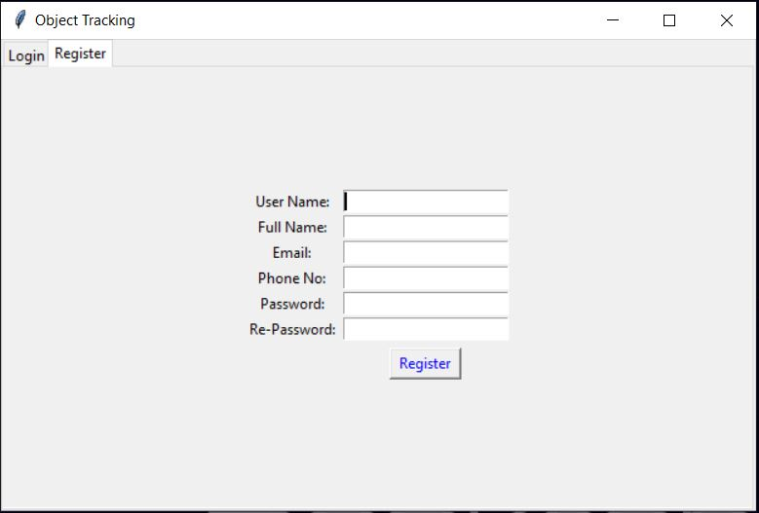
Samples

Slide 9
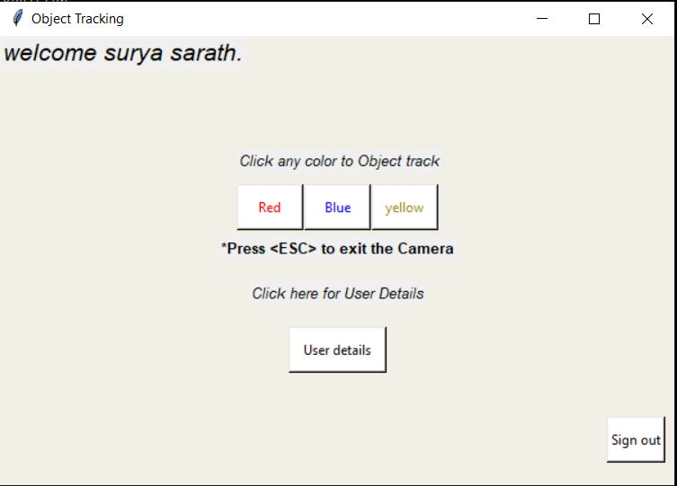
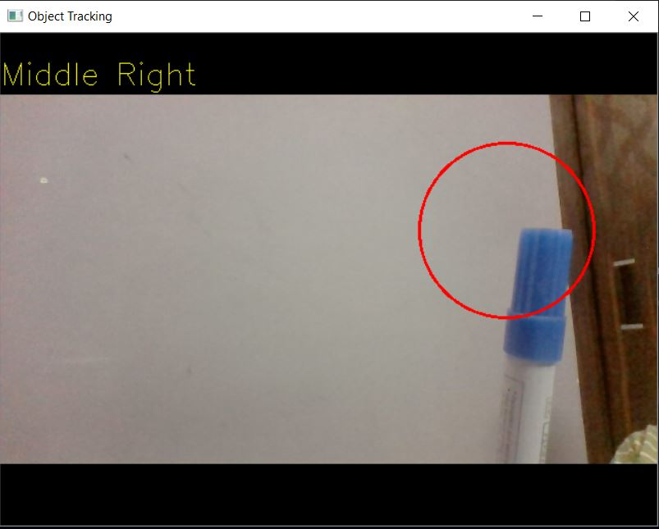
Samples

Slide 10
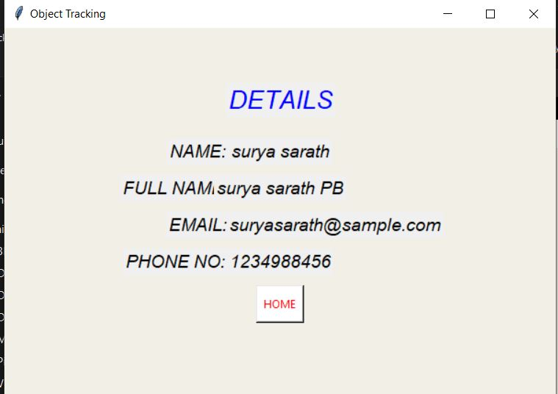
Samples

Slide 11
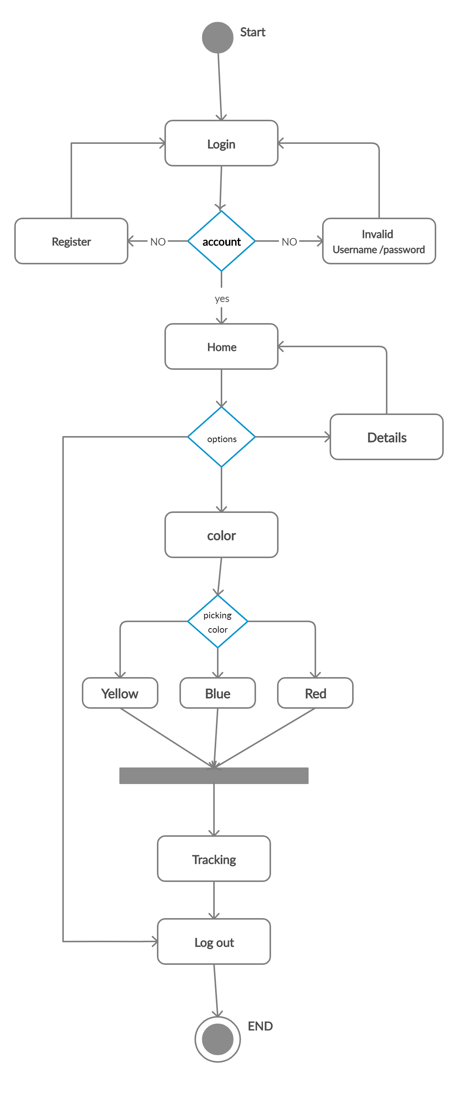
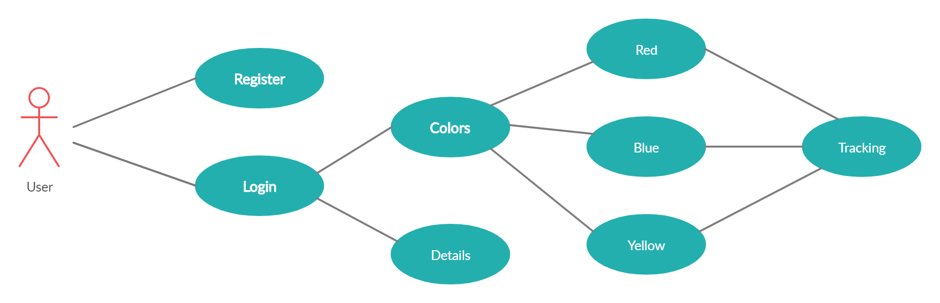
UML

Slide 12

Future ?
Used to Tracking Criminals
4
Vehicles
3
2
Guns
1
Illegal Activities
Notes:
Notes to presenter:
What steps will you be taking as a result of this learning experience?
Did you learn from any failed experiences? How will you do things differently?
What advice will you give to others so they can learn from your experiences?
How can you share what you learned with a real-world audience?
Some examples of next steps might be:
After delivering my first persuasive presentation, I am thinking about joining the debate team.
After making my first film, I’m considering entering it in our school film festival or local film festival.
After connecting with this career expert, I’d like to do some research on that career field because it sounds interesting to me.
This SmartArt allows you add images and text to help outline your process. If a picture is worth a thousand words, then pictures and words should help you communicate this reflection on learning perfectly! You can always click on Insert>SmartArt to change this graphic or select the graphic and click on the Design contextual menu to change the colors.
Feel free to use more than one slide to share your next steps. It also helps to add some video content to explain your message.

Slide 13
Thank You

